Slide 2
Defining a Pointer of Class type
class Simple{
public:
int a;
};
int main(){
Simple obj;
Simple* ptr; // Pointer of class type
ptr = &obj;
cout << obj.a;
cout << ptr->a; // Accessing member with pointer
}

Slide 3
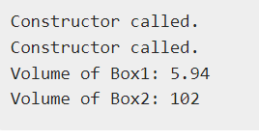
int main(void) {
Box Box1(3.3, 1.2, 1.5); // Declare box1
Box Box2(8.5, 6.0, 2.0); // Declare box2
Box *ptrBox; // Declare pointer to a class.
// Save the address of first object
ptrBox = &Box1;
// Now try to access a member using member access operator
cout << "Volume of Box1: " << ptrBox->Volume() << endl;
// Save the address of second object
ptrBox = &Box2;
// Now try to access a member using member access operator
cout << "Volume of Box2: " << ptrBox->Volume() << endl;
return 0;
}
class Box {
public:
// Constructor definition
Box(double l = 2.0, double b = 2.0, double h = 2.0) {
cout <<"Constructor called." << endl;
length = l;
breadth = b;
height = h;
}
double Volume() {
return length * breadth * height;
}
private:
double length; // Length of a box
double breadth; // Breadth of a box
double height; // Height of a box
};

Slide 4
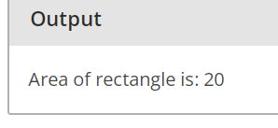
class Rectangle
{
private:
int length;
int breadth;
public:
Rectangle(int l, int b)
{
length=l;
breadth=b;
}
int getArea()
{
return 2*length*breadth;
}
};
int main()
{
// creating an object of Rectangle
Rectangle var1(5,2); // parameterized constrcutor
/* creating a pointer of Rectangle type &
assigning address of var1 to this pointer */
Rectangle* ptr = &var1;
/* calculating area of rectangle by using pointer
ptr to call the objects getArea() function
*/
int area = ptr->getArea();
cout<<"Area of rectangle is: "<<area;
return 0;
}

Slide 5
class Rectangle
{
private:
int length;
float breadth;
public:
void setData(int l, int b)
{
length=l;
breadth=b;
}
int getArea()
{
return 2*length*breadth;
}
};
int main()
{
// creating an object array of Rectangle
Rectangle var[2];
// setting values of array elements
var[0].setData(5,2);
var[1].setData(3,2);
/* creating a pointer of Rectangle type &
assigning address of var to this pointer */
Rectangle* ptr;
ptr = var;
/* calculating area of rectangles by using pointer
ptr to call the objects getArea() function
*/
for(int i=0;i<2;i++)
{
cout<<"Area of Rectangle"<<(i+1)<<" : "<<(ptr+i)->getArea()<<endl;
}
return 0;
}

Slide 6
class Date{
private:
short int dd, mm, yy;
public:
Date() //constrctor:
{
dd = mm = yy = 0;
}
void getdata(int i, int j, int k) {
dd = i;
mm = j;
yy = k;
}
void prndata(void)
{
cout<<"\nData is "<<dd<<"/"<<mm<<"/"<<yy<<"\n";
}
};
main(){
Date D1; //simple object having type Data:
Date *dptr; //Pointer Object having type Date:
cout<<"Initializing data members : 19, 10, 2016"<<endl;
D1.getdata(19,10,2016);
cout<<"Printing members using the object ";
D1.prndata();
dptr = &D1;
cout<<"Printing members using the object pointer ";
dptr->prndata();
cout<<"\nInitializing with values 20, 10, 2016"<<endl;
dptr->getdata(20, 10, 2016);
cout<<"printing members using the object ";
D1.prndata();
cout<<"Printing members using the object pointer ";
dptr->prndata();
return 0;
}

Slide 8
class Data{
public:
int a;
void print() {
cout << "a is "<< a;
}
};
int main(){
Data d, *dp;
dp = &d; // pointer to object
int Data::*ptr=&Data::a; // pointer to data member 'a'
d.*ptr=10;
d.print();
dp->*ptr=20;
dp->print();
}
Pointer to Data Members of Class

Slide 9
Pointer to Member Functions of Class
return_type (class_name::*ptr_name) (argument_type) = &class_name::function_name;
class Data{
public:
int f(float) {
return 1;
}
};
int (Data::*fp1) (float) = &Data::f; // Declaration and assignment
int (Data::*fp2) (float); // Only Declaration
int main(){
fp2 = &Data::f; // Assignment inside main()
}

Slide 11
C++ Virtual Functions
A virtual function is another way of implementing run-time polymorphism in C++.
It is a special function defined in a base class and redefined in the derived class.
virtual functions allow derived classes to provide different versions of a base class function
To declare a virtual function, you should use the virtual keyword.
Using virtual functions in the base class ensures that the function can be overridden in these cases.
Thus, virtual functions actually fall under function overriding.
Virtual Function is a function in base class, which is overrided in the derived class, and which tells the compiler to perform Late Binding on this function.

Slide 12
Virtual functions cannot be static and also cannot be a friend function of another class.
Virtual functions should be accessed using pointer or reference of base class type to achieve run time polymorphism.
The prototype of virtual functions should be same in base as well as derived class.
They are always defined in base class and overridden in derived class.
It is not mandatory for derived class to override (or re-define the virtual function), in that case base class version of function is used.
A class may have virtual destructor but it cannot have a virtual constructor

Slide 13
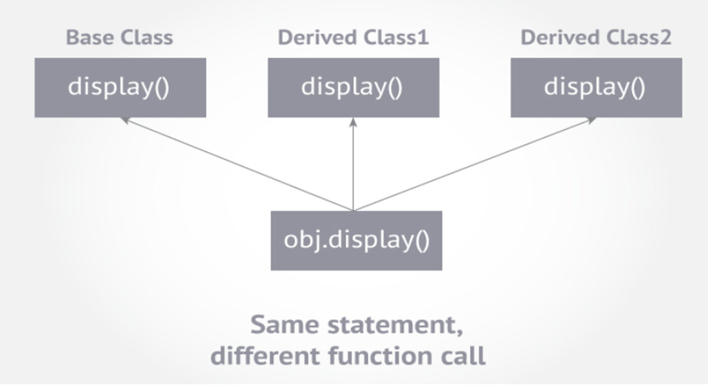

Slide 14


class Base{
public:
void show() {
cout << "Base class";
}
};
class Derived:public Base{
public:
void show()
{
cout << "Derived Class";
}
}
int main(){
Base* b; //Base class pointer
Derived d; //Derived class object
b = &d;
b->show(); //Early Binding Ocuurs
}
class Base{
public:
virtual void show()
{
cout << "Base class\n";
}
};
class Derived:public Base{
public:
void show()
{
cout << "Derived Class";
}
}
int main(){
Base* b; //Base class pointer
Derived d; //Derived class object
b = &d;
b->show(); //Late Binding Ocuurs
}

Slide 15
class base {
public:
void fun_1() { cout << "base-1\n"; }
virtual void fun_2() { cout << "base-2\n"; }
virtual void fun_3() { cout << "base-3\n"; }
virtual void fun_4() { cout << "base-4\n"; }
};
class derived : public base {
public:
void fun_1() { cout << "derived-1\n"; }
void fun_2() { cout << "derived-2\n"; }
void fun_4(int x) { cout << "derived-4\n"; }
};
// CPP program to illustrate // working of Virtual Functions
int main() {
base* p;
derived obj1;
p = &obj1;
// Early binding because fun1() is non-
//virtual in base
p->fun_1();
// Late binding
p->fun_2();
// Late binding
p->fun_3();
// Late binding
p->fun_4();
// Early binding but this function call is illegal //(produces error) becasue pointer is of base type and //function is of derived class
// p->fun_4(5);
}

Slide 17
class base {
public:
virtual void print() {
cout << "print base class" << endl;
}
void show() {
cout << "show base class" << endl;
}
};
class derived : public base {
public:
void print() {
cout << "print derived class" << endl;
}
void show() {
cout << "show derived class" << endl;
}
};
int main() {
base* bptr;
derived d;
bptr = &d;
bptr->print(); // virtual function, binded at runtime
bptr->show(); // Non-virtual function, binded at compile time
}
Explanation:
Runtime polymorphism is achieved only through a pointer (or reference) of base class type.
Also, a base class pointer can point to the objects of base class as well as to the objects of derived class.
In above code, base class pointer ‘bptr’ contains the address of object ‘d’ of derived class.
Late binding(Runtime) is done in accordance with the content of pointer (i.e. location pointed to by pointer)
Early binding(Compile time) is done according to the type of pointer, since print() function is declared with virtual keyword so it will be bound at run-time (output is print derived class as pointer is pointing to object of derived class ) and
show() is non-virtual so it will be bound during compile time(output is show base class as pointer is of base type ).

Slide 19
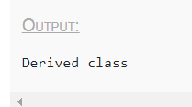
class A{
public:
virtual void show()
{
cout << "Base class\n";
}
};
class B: public A{
private:
virtual void show()
{
cout << "Derived class\n";
}
};
int main(){
A *a;
B b;
a = &b;
a->show();
}
We can call private function of derived class from the base class pointer with the help of virtual keyword. Compiler checks for access specifier only at compile time. So at run time when late binding occurs it does not check whether we are calling the private function or public function.

Slide 21
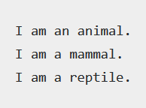
Ör:
#include <iostream>
using namespace std;
class Animal{
public:
virtual void my_features()
{
cout << "I am an animal.";
}
};
class Mammal : public Animal{
public:
void my_features()
{
cout << "\nI am a mammal.";
}
};
class Reptile : public Animal{
public:
void my_features() {
cout << "\nI am a reptile.";
}
};
//intermediate function
void intermediate_func(Animal *a1){
a1->my_features();
}
int main(){
Animal *obj1 = new Animal;
Mammal *obj2 = new Mammal;
Reptile *obj3 = new Reptile;
intermediate_func(obj1);
intermediate_func(obj2);
intermediate_func(obj3);
return 0;
}

Slide 23
// C++ program to demonstrate the use of virtual function
#include <iostream>
#include <string>
using namespace std;
class Animal {
private:
string type;
public:
// constructor to initialize type
Animal() : type("Animal") {}
// declare virtual function
virtual string getType() {
return type;
}
};

Slide 24
class Dog : public Animal {
private:
string type;
public:
Dog() : type("Dog") {} // constructor to initialize type
string getType() override {
return type;
}
};
class Cat : public Animal {
private:
string type;
public:
Cat() : type("Cat") {} // constructor to initialize type
string getType() override {
return type;
}
};

Slide 25
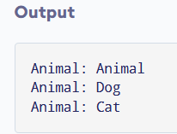
void print(Animal* ani) {
cout << "Animal: " << ani->getType() << endl;
}
int main() {
Animal* animal1 = new Animal();
Animal* dog1 = new Dog();
Animal* cat1 = new Cat();
print(animal1);
print(dog1);
print(cat1);
return 0;
}
We then call the print() function using these pointers:
When print(animal1) is called, the pointer points to an Animal object. So, the virtual function in Animal class is executed inside of print().
When print(dog1) is called, the pointer points to a Dog object. So, the virtual function is overridden and the function of Dog is executed inside of print().
When print(cat1) is called, the pointer points to a Cat object. So, the virtual function is overridden and the function of Cat is executed inside of print().

Slide 27
#include <iostream>
using namespace std;
class ClassA {
public:
virtual void show() {
cout << "The show() function in base class invoked..." << endl;
}
};
class ClassB :public ClassA {
public:
void show() {
cout << "The show() function in derived class invoked...";
}
};
int main() {
ClassA* a;
ClassB b;
a = &b;
a->show();
}

Slide 29
A pure virtual function (or abstract function) in C++ is a virtual function for which we don’t have implementation, we only declare it.
A pure virtual function is declared by assigning 0 in declaration.
See the following example.
// An abstract class
class Test
{
// Data members of class
public:
// Pure Virtual Function
virtual void show() = 0;
/* Other members */
};
pure virtual function
Pure virtual functions are used
if a function doesn't have any use in the base class
but the function must be implemented by all its derived classes

Slide 30
class Base {
int x;
public:
virtual void fun() = 0;
int getX() { return x; }
};
// This class inherits from Base and implements fun()
class Derived: public Base {
int y;
public:
void fun() { cout << "fun() called"; }
};
int main(void) {
Derived d;
d.fun();
return 0;
}

Slide 31

class Base {
public:
virtual void show() = 0; //Pure Virtual Function
};
void Base :: show() { //Pure Virtual definition
cout << "Pure Virtual definition\n";
}
class Derived:public Base{
public:
void show() {
cout << "Implementation of Virtual Function in Derived class\n";
}
};
int main(){
Base *b;
Derived d;
b = &d;
b->show();
}

Slide 32
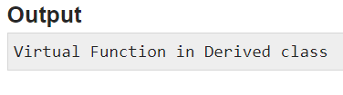
#include<iostream>
using namespace std;
class B {
public:
virtual void s() = 0; // Pure Virtual Function
};
class D:public B {
public:
void s() {
cout << "Virtual Function in Derived class\n";
}
};
int main() {
B *b;
D dobj;
b = &dobj;
b->s();
}

Slide 34
Suppose, we have derived Triangle, Square and Circle classes from the Shape class, and we want to calculate the area of all these shapes.
In this case, we can create a pure virtual function named calculateArea() in the Shape.
Since it's a pure virtual function, all derived classes Triangle, Square and Circle must include the calculateArea() function with implementation.
A pure virtual function doesn't have the function body and it must end with = 0.
class Shape {
public:
// creating a pure virtual function
virtual void calculateArea() = 0;
};

Slide 35

class Polygon {
protected:
int width, height;
public:
Polygon (int a, int b) : width(a), height(b) {}
virtual int area (void) =0;
void printarea()
{ cout << this->area() << '\n'; }
};
class Rectangle: public Polygon {
public:
Rectangle(int a,int b) : Polygon(a,b) {}
int area()
{ return width*height; }
};
class Triangle: public Polygon {
public:
Triangle(int a,int b) : Polygon(a,b) {}
int area()
{ return width*height/2; }
};
int main () {
Polygon * ppoly1 = new Rectangle (4,5);
Polygon * ppoly2 = new Triangle (4,5);
ppoly1->printarea();
ppoly2->printarea();
delete ppoly1;
delete ppoly2;
return 0;
}

Slide 37
/* Pure Virtual Function example:*/
class Shape {
protected:
float l;
public:
/*this function is not virtual. */
void get_data() {cin>>l;
}
/* Pure virtual function */
virtual float area() = 0;};
class Square : public Shape { //derived class.
public:
float area() {
return l*l;
}
};
class Circle : public Shape { //derived class.
public:
float area() {
return 3.14*l*l;
}
};
int main(){
Square squ; //object of type Square:
Circle cir; //Object of type Circle:
cout<<"Enter length to calculate area of a square: ";
squ.get_data();
cout<<"Area of square: "<<squ.area();
cout<<"\n\nEnter radius to calculate area of a circle:";
cir.get_data();
cout<<"Area of circle: "<<cir.area();
return 0;
}

Slide 39
Friend class and function in C++
Syntax of friend class:
class S; //forward declaration
class P{
// Other Declarations
friend class S;
};
class S{
// Declarations
};
class S is a friend of class P. As a result class S can access the private data members of class P.
However, this does not mean that class P can access private data members of class S.
A forward declaration informs the compiler about an entity’s existence before the entity is explicitly defined.

Slide 40
class A{
……
friend class B;
};
class B{
……..
};
class B is a friend of class A.
So class B can access the private and protected members of class A.

Slide 41
Friend class and function in C++
Friend Class
A friend class can access private and protected members of other class in which it is declared as friend.
It is sometimes useful to allow a particular class to access private members of other class.
For example a LinkedList class may be allowed to access private members of Node.
class Node {
private:
int key;
Node* next;
/* Other members of Node Class */
// Now class LinkedList can
// access private members of Node
friend class LinkedList;
};

Slide 42
class Square;
class Rectangle {
int width, height;
public:
int area ()
{return (width * height);}
void convert (Square a);
};
class Square {
friend class Rectangle;
private:
int side;
public:
Square (int a) : side(a) {}
};
Similar to friend functions, a friend class is a class whose members have access to the private or protected members of another class:
In this example, class Rectangle is a friend of class Square allowing Rectangle's member functions to access private and protected members of Square.
void Rectangle::convert (Square a) {
width = a.side;
height = a.side;
}
int main () {
Rectangle rect;
Square sqr (4);
rect.convert(sqr);
cout << rect.area();
return 0;
}

Slide 43

class XYZ {
private:
char ch='A';
int num = 11;
public:
/* This statement would make class ABC * a friend class of XYZ, this means that * ABC can access the private and protected * members of XYZ class. */
friend class ABC;
};
class ABC {
public:
void disp(XYZ obj){
cout<<obj.ch<<endl;
cout<<obj.num<<endl;
}
};
int main() {
ABC obj;
XYZ obj2;
obj.disp(obj2);
return 0;
}

Slide 44

class ClassY;
class ClassX {
int digit1;
friend class ClassY; // friend class declaration
public:
ClassX() : digit1(10) {} // constructor to initialize num1 to 10
};
class ClassY {
int digit2;
public:
ClassY() : digit2(5) {} // constructor to initialize num2 to 5
// member function to multiply num1 // from ClassX with num2 from ClassY
int multiply() {
ClassX m;
return m.digit1 * digit2;
}
};
int main() {
ClassY n;
cout << "Multiplication: " << n.multiply();
return 0;
}

Slide 45
class Point {
friend class Triangle;
private:
int x, y;
}
//triangle created from point plotted on x-y plane, using x, y, and the origin
class Triangle {
public:
int Base(Point p){
return p.x; //direct access to x, which is private member of p object
}
int Height(Point p){
return p.y;
}
double Area(Point p){
return p.x * p.y / 2;
}
}

Slide 46
class Account{
public:
Account(double balance){
this->balance = balance;
}
private:
friend class DebitCard; //grant friendship
double balance;
void withdraw(double amt){
this->balance -= amt;
cout << "Withdraw Successful" << endl;
}
void deposit(double amt){
this->balance += amt;
cout << "Deposit Successful" << endl;
}
};
class DebitCard{
public:
void debit(Account &acc, double amt){
//can access withdraw() of Account using acc
acc.withdraw(amt);
}
};
int main() {
Account account(109643.00);
DebitCard debitcard;
//calling debit() of DebitCard
debitcard.debit(account, 89452.00);
return 0;
}

Slide 48
Friend Function
Like friend class, a friend function can be given special grant to access private and protected members.
A friend function can be:
a) A method of another class
b) A global function
class Node {
private:
int key;
Node* next;
/* Other members of Node Class */
friend int LinkedList::search();
// Only search() of linkedList
// can access internal members
};

Slide 49
Following are some important points about friend functions and classes:
1) Friends should be used only for limited purpose.
2) Friendship is not mutual. If class A is a friend of B, then B doesn’t become a friend of A automatically.
3) Friendship is not inherited
4) The concept of friends is not there in Java.

Slide 50

class integer{
int a, b;
public:
void set_value() {
a=50;
b=30;
}
friend int mean(integer s); //declaration of friend function
};
int mean(integer s){
return int(s.a+s.b)/2.0; //friend function definition
}
int main(){
integer c;
c.set_value();
cout<< "Mean value:" <<mean(c);
return 0;
}

Slide 51

class XYZ {
private:
int num=100;
char ch='Z';
public:
friend void disp(XYZ obj);
};
//Global Function
void disp(XYZ obj){
cout<<obj.num<<endl;
cout<<obj.ch<<endl;
}
int main() {
XYZ obj;
disp(obj);
return 0;
}

Slide 52

class Rectangle {
int width, height;
public:
Rectangle() {}
Rectangle (int x, int y) : width(x), height(y) {}
int area() {return width * height;}
friend Rectangle duplicate (const Rectangle&);
};
Rectangle duplicate (const Rectangle& param)
{
Rectangle res;
res.width = param.width*2;
res.height = param.height*2;
return res;
}
int main () {
Rectangle foo;
Rectangle bar (2,3);
foo = duplicate (bar);
cout << foo.area() << '\n';
return 0;
}
A non-member function can access the private and protected members of a class if it is declared a friend of that class.
That is done by including a declaration of this external function within the class, and preceding it with the keyword friend:
The duplicate function is a friend of class Rectangle.
Therefore, function duplicate is able to access the members width and height (which are private) of different objects of type Rectangle.
It simply has access to its private and protected members without being a member.

Slide 54
class className1{
// Other Declarations
int functionName1(); // member function of className1
};
class className2
{
// Other Declarations
friend int className1::functionName(); //The functionName1() is a friend of className2
};

Slide 55
class B; // forward declaration
class A {
private:
int numA;
public:
A(): numA(12) { }
friend int add(A, B); // friend function declaration
};
class B {
private:
int numB;
public:
B(): numB(1) { }
// friend function declaration
friend int add(A , B);
};
// Function add() is the friend function of classes A and B
// that accesses the member variables numA and numB
int add(A objectA, B objectB)
{
return (objectA.numA + objectB.numB);
}
int main()
{
A objectA;
B objectB;
cout<<"Sum: "<< add(objectA, objectB);
return 0;
}

Slide 56
class B;
class A {
public:
void showB(B&);
};
class B {
private:
int b;
public:
B() { b = 0; }
friend void A::showB(B& x); // Friend function
};
void A::showB(B& x){
// showB() is friend of B, it can access private members of B
std::cout << "B::b = " << x.b;
}
int main()
{
A a;
B x;
a.showB(x);
return 0;
}

Slide 57
class A {
int a;
public:
A() { a = 0; }
// global friend function
friend void showA(A&);
};
void showA(A& x){
// Since showA() is a friend, it can access // private members of A
std::cout << "A::a=" << x.a;
}
int main(){
A a;
showA(a);
return 0;
}

Slide 58
class beta; //needed for frifunc declaration
class alpha {
private:
int data;
public:
alpha() : data(3) { } //no-arg constructor
friend int frifunc(alpha, beta); //friend function
};
//////////////////////////////////
class beta {
private:
int data;
public:
beta() : data(7) { } //no-arg constructor
friend int frifunc(alpha, beta); //friend function
};
//////////////////////////////////////////////////
int frifunc(alpha a, beta b) //function definition
{
return( a.data + b.data );
}
//--------------------------------------------------------------
int main() {
alpha aa;
beta bb;
cout << frifunc(aa, bb) << endl; //call the function
return 0;
}

Slide 59
class A {
protected:
int x;
public:
A() { x = 0;}
friend void show();
};
class B: public A {
public:
B() : y (0) {}
private:
int y;
};
void show() {
B b;
std::cout << "The default value of A::x = " << b.x;
// Can't access private member declared in class 'B'
std::cout << "The default value of B::y = " << b.y;
}
int main()
{
show();
getchar();
return 0;
}

Slide 60
class Test {
private:
int x, y, z;
public:
void input() {
cout << "Enter two numbers:";
cin >> x>>y;
}
friend void add(Test &t);
void display() {
cout << "sum is:" << z;
}
};
void add(Test &t) {
t.z = t.x + t.y;
}
int main() {
Test t;
t.input();
add(t);
t.display();
return 0;
}

